Slide 1
Power BI Paginated Reports
TECHNOLOGY

Slide 2
01
Introduction & Overview

Slide 3
Course Goals
Define Course Objectives
Expected Outcomes
Mechanics & usage of Power BI Paginated Reports to create detailed reports providing business insights and user interactivity in a printable format
Through hands-on, report creation proficiency, including data integration, report design, and consumable delivery
Notes:
Contrast with PBIX: paginated is about documents (invoices, statements, regulatory forms), not exploratory visuals.

Slide 4
Paginated vs. Interactive vs. Analytical Reports
01
02
Paginated Reports
Interactive Reports
Power BI-based reports designed for printing or PDF generation using a fixed layout
Fixed layout, deterministic pagination
Best for operational documents, pixel-perfect exports, long tables
Reports that allow user engagement and real-time data manipulation within Power BI
Visual exploration, cross-filtering, drill-downs
Best for dashboards and ad-hoc analysis
03
Analytical Reports
Reports used for data exploration and for identifying business trends and gaining intelligence about operations, products, customers, etc.
Semantic models, DAX/SQL workloads, data science outputs
Best for curated datasets, metrics, and advanced analytics
Notes:
If you have experience with SSRS (SQL Server Reporting Services), Power BI Paginated Reports (and the tool used with them – Power BI Report Builder) will look/seem very familiar.

Slide 5
02
Paginated Report Architecture

Slide 6


Report Definition Language (RDL) Builder Basics
RDL Structure
01
RDL provides an XML-based structure built out through graphical interaction with report builder
Includes <Report> root with <DataSources>, <DataSets>, <ReportParameters>, <Body>, etc. elements in hierarchy
Building Reports
02
Supports templating
Various ways to display data for interaction and print: Tablix (tables), Charts, Subreports, Images, Matrices, Lists, etc.
Supports coding (on different levels) for intelligent population, formatting, etc.

Slide 7
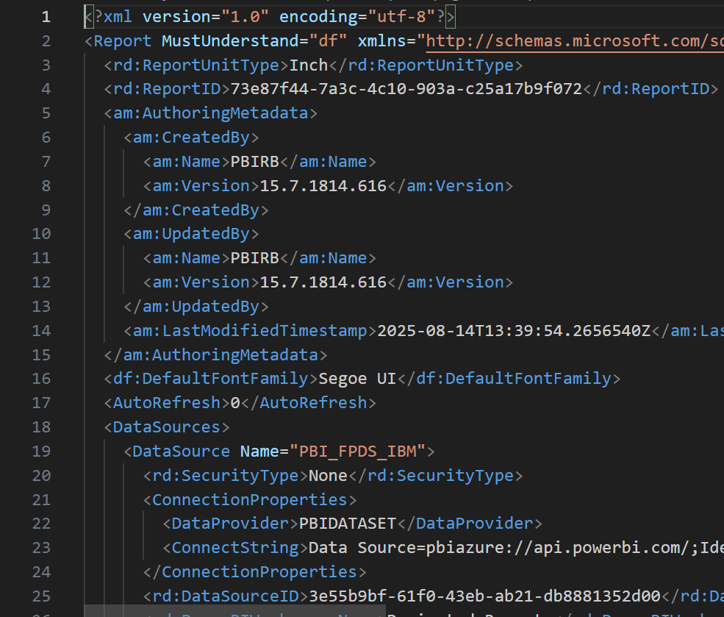
Report Definition Language (RDL) Builder Basics

Slide 8
Architecture Considerations
Infrastructure Requirements
Selected approach depends on operational environment and usage patterns for the reports – balance cost vs. ease of use/management and sophistication
Scalability
Depending on selected route (on-prem vs. in the Cloud), approach to scaling the system to meet spikes in demand (balanced against optimized cost) will be critical
Notes:
On-prem – obviously more work on the part of the company utilizing; cloud is built for elastic scalability

Slide 9
Power BI Report Server vs. Service
Report Server
Report Service
On-premises solution for managing and deploying reports, including paginated reports
Cloud-based solution for distributing and accessing reports, including richer mechanism for sharing and collaboration through workspaces
Notes:
Here’s a comparison of Power BI Report Server and Power BI Service:
Deployment: Power BI Report Server is an on-premises solution, while Power BI Service is a cloud-based service.
Functionality: Both services allow for the creation and sharing of interactive reports and dashboards, but Power BI Service offers more features related to collaboration and sharing.
Licensing: Power BI Report Server is included with Power BI Premium or SQL Server Enterprise Software Assurance licenses, whereas Power BI Service operates on a subscription model.
Target Users: Power BI Report Server is typically used by organizations that require data to remain on-premises due to compliance or security reasons, while Power BI Service is suitable for users who prefer cloud solutions for flexibility and scalability.
Updates: Power BI Service receives more frequent updates and new features compared to Power BI Report Server, which has a more stable release cycle.

Slide 10
Power BI Report Server vs. Service (Deployment)
Report Server
Report Service
Native mode, data-driven subscriptions, and custom branding
Windows/AD AuthN and role-based security
Cloud distribution, email subscriptions, embedding
Connect to Power BI semantic models via DAX queries
Capacity considerations for concurrency and rendering
Notes:
Choose Service for cloud scale & integration; Report Server for data residency or strict on-prem requirements.

Slide 11
Processing Pipeline
Parameter Binding
Query Execution
Report Processing
Rendering Extension
Notes:
Rendering includes interactive, export to PDF, Word, Excel, etc.
Keep the mental model: data retrieval is decoupled from rendering; layout complexity affects render time more than query time.

Slide 12
03
Data Connections and Datasets in a Paginated Report

Slide 13

Overview, Considerations, and Mechanics
Connection Methods
Can include on-prem gateways and cloud connections
Stored credentials vs. OAuth
Data privacy considerations
Single sign-on where applicable
Data Sources
STEP 03
Common sources include Power BI datasets (DAX), SQL Server/Azure SQL (T-SQL), Oracle, SAP, OData, REST (via JSON/XML), SharePoint lists, etc.
STEP 02
STEP 01
Dataset Patterns
DAX dataset: EVALUATE … against a Power BI model (no import cache; live)Stored credentials vs. OAuth
Relational dataset: parameterized T-SQL
Can use stored procedures for reuse and performance

Slide 14
Datasets as Parameters
Datasets
Reference datasets can be used to source parameter options dynamically
Selected parameter values (sourced from datasets) can be used to filter displays

Slide 15
04
Designing Paginated Reports

Slide 16
Layout Design
Template Selection
02
Choose from a variety of templates to design the layout of paginated reports, ensuring consistency and professionalism
01
Custom Layouts
Can create custom layouts tailored to specific business needs and reporting requirements
Notes:
Templates & Page Setup
Set page size, margins, and interactive size up front
Use corporate templates (fonts, header/footer, logo, page numbers)
Data Regions & Grouping
Tablix with row/column groups, details, and totals
Drillthrough pages for detail vs. summary separation
Interactivity
Parameters (cascading), interactive sort, document map, show/hide with toggles
Decide your pagination strategy early—avoid late reflows by finalizing page settings before populating content.

Slide 17
Report Items and Properties
Adding Report Items
01
Add various report items such as tables, matrices, and charts to summarize and visualize data
Configuring Properties
02
Configure properties of report items (including dynamically via “code”) to enhance data representation and user experience
Notes:
Expressions
Format strings: currency, date, percent; custom IIF/ISNOTHING logic
Reuse via report/global variables and shared code where needed

Slide 18
Formatting and Styling
01
02
Styling Techniques
Conditional Formatting
Apply styling techniques to improve the visual appeal and readability of reports through colors, fonts, and borders
Implement conditional formatting to highlight critical data points automatically based on specified criteria
Notes:
Conditional Formatting
Data bars/icons with business rules
Visibility/row highlighting based on thresholds or role
Professional Polish
Consistent number/date formats; alignment; thousand separators
Avoid nested Tablix; use whitespace and consistent padding
Display currency values as localized currency and conditionally format negative vs. positive amounts
Keep expressions deterministic; avoid heavy string ops in large detail rows to reduce CPU during render.

Slide 19
05
Building for Interactivity

Slide 20


Understanding Drill-through
01.
Definition of Drill-through
Drill-through reports allow users to navigate from a summarized view to detailed data - this enhances data exploration and analysis
02.
Use Cases
Common use cases include sales reports where clicking on a region drills down to city-level data, or detailed financial reporting from aggregated figures

Slide 21
Implementing Drill-through
01
02
Steps for Setup
Best Practices
Setting up drill-through involves configuring filters and linking the summarized data to related details
Ensure clear call-to-action and intuitive navigation paths to improve user experience when using drill-through functionality
Notes:
User flow should be clear

Slide 22




Document Maps
What Are Document Maps?
01
Document maps provide a navigable structure in paginated reports, making it easier for users to locate sections and understand report flow
Benefits
02
They enhance report usability by allowing quick access to different report sections, especially in large and complex reports

Slide 23

Bookmarks
Purpose of Bookmarks
Creating Bookmarks
Use Cases
Bookmarks save report states or views, enabling users to jump back to specific parts of the report seamlessly
Creating bookmarks in the report involves selecting the desired report view and saving it, which can be accessed via a click (or action) later
Bookmarks are useful for presentations or revisiting specific analysis stages in a report, providing a streamlined navigation experience

Slide 24
Basics of Toggle Visibility
What is Toggle Visibility?
Benefits for Users
This feature allows users to show or hide report elements dynamically, improving user control over the report content's visibility
Toggle visibility enhances user interactivity by reducing clutter and focusing attention on relevant data sections

Slide 25
Configuring Toggle Visibility
Steps to Implement
Best Practices
01
02
Configuration involves setting up condition-based visibility rules for report items within the report, allowing for dynamic content display
Use toggle visibility judiciously to avoid overwhelming users; maintain a balance between visible and hidden elements based on user needs

Slide 26
Introduction to Parameters
01
02
What are Parameters?
Benefits of Using Parameters
Parameters allow users to input values that dynamically control report data, enhancing the customization of report views and insights
Parameters enable personalized data exploration, allowing for filtering, sorting, and viewing data based on specific user selections
Notes:
We saw a reference to this earlier relative to datasets (that can be used to source parameters)

Slide 27

Setting Up Parameters
Steps for Configuration
Configuring parameters involves defining parameter fields, setting default values, and linking them with report datasets for dynamic interactions
Use Cases
Common use cases include generating reports based on date ranges, geographical filters, or specific product selections to tailor insights

Slide 28
Designing User-Friendly Reports
Importance of User-Friendly Design
Tips for Design
Effective design enhances report navigation and comprehension, facilitating better decision-making and user experience
Use consistent layouts, clear labels, and logical data groupings to improve readability and accessibility of reports

Slide 29
Utilizing Interactive Features
Interactive Elements
Ensuring Performance
Incorporate features such as tooltips, interactivity links, and visual cues to make reports more engaging and informational for users
Regularly test interactive features to ensure they do not negatively impact report performance, maintaining a smooth user experience

Slide 30
Ensuring Data Accuracy
Importance of Accuracy
Data Validation Techniques
Accurate data is crucial for reliable insights and decision-making, ensuring that interactive features deliver meaningful and trustworthy information
Implement robust validation procedures, regular audits, and clear data entry protocols to maintain data integrity in reports

Slide 31
User Testing and Feedback
Conducting User Testing
01
Regular user testing helps identify usability issues and gather feedback, enabling iterative improvements to report design and functionality
Incorporating Feedback
02
Actively seek and incorporate user feedback to refine report features, ensuring that they meet user needs and preferences effectively

Slide 32
06
Exporting and Sharing Reports

Slide 33
Export Options (Among Others)
PDF Export
Excel Export
Export paginated reports to PDF format for easy distribution and printing
Export reports to Excel for further data analysis and manipulation – allows a report to expose data that can be manipulated and then used as a follow-up reporting source
Notes:
Export Targets
PDF (print-ready, compliance), Excel (analysis), Word/PowerPoint (narrative), CSV/XML (downstream loads)
Decide export grain: if Excel consumers need pivots, consider sending aggregated + detail tabs separately.

Slide 34
Report Sharing Methods
01
02
Email Distribution
Embedding Reports
Reports can be distributed email directly from the Power BI Report Server or Service
Paginated reports can be embedded in applications or websites for wider accessibility – there’s even a Paginated Report visualization in Power BI
Notes:
Subscriptions & Delivery
Time-based and event-based subscriptions
Attachments vs. links; parameterized variants per audience
Embedding & Integration
App/portal embedding with secured parameters
Deep links with parameter presets

Slide 35



Security Considerations
Access Permissions
Data Encryption
Set access permissions to control who can view and interact with reports, ensuring data security
Implement data encryption practices to protect sensitive information within paginated reports
Notes:
Multiple levels of permissions – data source and report
Expose over secure channels (TSL/SSL or encrypted email)
Access Control
Role-based access (folder/report/item-level)
Parameter defaults scoped by role where applicable
Data Protection
Encrypted connections and at-rest encryption (platform-managed)
Limit data exposure in exports; watermark sensitive PDFs
Operational Governance
Naming/versioning conventions; promote via Dev/Test/Prod
Auditing: usage logs, change history, and ownership rotation
Treat subscriptions as data distribution—apply least privilege and review recipients quarterly.

Slide 36
07
Performance Optimization

Slide 37
Report Rendering
Rendering Time
01
Analyze factors affecting the rendering time of reports and techniques to optimize performance
Resource Utilization
02
Optimize resource utilization to balance load and improve the efficiency of report generation
Notes:
All translates to cost – either execution cost, financial cost, usability cost. A report that takes forever likely won’t be used (often). Going for access to near real-time insights.
Rendering Performance
Avoid deeply nested regions and excessive page breaks
Turn off “CanShrink/CanGrow” where stable sizing improves pagination
Use images sparingly; prefer embedded resources over remote

Slide 38


Query Performance
Efficient Queries
Write efficient queries to minimize data retrieval time and enhance overall report performance
Query Optimization
Employ query optimization strategies to ensure quick and accurate data retrieval from various sources
Notes:
Query Performance
Push filters to source; avoid SELECT *
Pre-aggregate with views/SPs; minimize row cardinality

Slide 39
Caching Strategies
Data Caching
Caching Best Practices
Implement data caching techniques to reduce query load and improve report responsiveness
Follow best practices in caching to maintain data accuracy while enhancing performance
Notes:
Caching & Snapshots
Execution caching for repeat parameter sets
Scheduled snapshots for heavy, predictable runs
Diagnostics
Capture render vs. data time in execution logs
Profile slow parameters and high-cardinality groupings
Tune both sides: a fast query can still yield slow renders if the layout is complex or pagination is unstable.

Slide 40
08
Demo
Notes:
Bookmark, caching, link between reports, Paginated Report visualization

Slide 41
Thanks
TECHNOLOGY

